Slide 1
Problem Statement
Vehicle Cut-in Detection
Madan Raj Upadhyay
mu0910@srmist.edu.in

Slide 2
Unique Idea Brief (Solution)
Dataset:
Utilize the Indian Driving Dataset (IDD) Temporal, which includes a variety of driving scenarios with Indian vehicles.
Training:
Train a YOLOv8 model on the dataset for vehicle detection.
Tracking:
Use SORT (Simple Online and Realtime Tracking) along with YOLOv8 for tracking detected vehicles.
Velocity Calculation:
Calculate the velocity of detected vehicles based on their movement across frames.
Time to Collision (TTC):
Compute the time to collision based on the velocity and relative position of vehicles.
Warning System:
Print a warning if the TTC is less than a specified threshold to alert the driver.

Slide 3
Features Offered
Real-time Vehicle Detection:
High accuracy in detecting vehicles using YOLOv8.
Efficient Tracking:
Real-time tracking of vehicles using SORT.
Velocity Estimation:
Accurate calculation of vehicle velocities.
Collision Prediction:
Predicts potential collisions and computes TTC.
Warning System:
Alerts drivers with warnings if a collision is imminent

Slide 4
Process flow
Data Collection:
Collect video data from the IDD Temporal dataset.
Preprocessing:
Preprocess the data to fit the input requirements of the YOLOv8 model.
Model Training:
Train the YOLOv8 model on the preprocessed dataset.
Detection and Tracking:
Use the trained YOLOv8 model to detect vehicles and SORT for tracking.
Velocity Calculation:
Calculate the velocity of each detected vehicle.
TTC Calculation:
Compute the time to collision for each vehicle.
Warning Generation:
Generate warnings if the TTC is below a certain threshold.

Slide 5
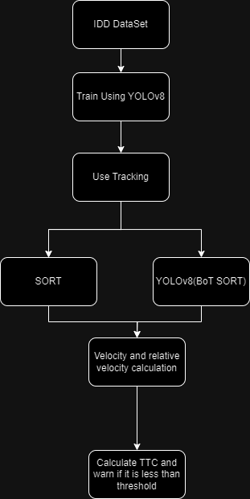
Architecture Diagram

Slide 6
Technologies used
Dataset:
Indian Driving Dataset (IDD) Temporal
Detection Model:
YOLOv8
Tracking Algorithm:
SORT, BoT-SORT(YOLOv8)
Programming Language:
Python
Libraries:
OpenCV, NumPy, Ultralytics
Tools:
VS Code, Google Colab etc..

Slide 7
Conclusion
Summary:
Effective vehicle cut-in detection system using YOLOv8 and SORT.
Real-time tracking and velocity estimation.
Accurate prediction of time to collision.
Warning system to enhance driver safety.

